Slide 1
Introduction to Cybersecurity
Chapter 5
Dr. Mohammed Tawfik

Slide 2
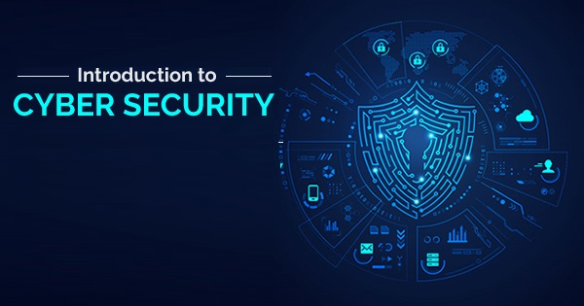
Chapter 5:
Cyber Crime, Kali Linux, Digital Forensics, Firewall , and Webs
Dr. Mohammed Tawfik

Slide 3
Outline
Cyber Crime
Kali Linux
Digital Forensics
Firewall
Web, Deep Web & Dark Web

Slide 4
Cyber Crime
• The Internet is growing rapidly. There are two sides to a coin. Internet also has it’s own disadvantages is cyber crime-illegal activity committed on the Internet.
• Crime committed using a computer and the internet to steal a person’s identity or illegal imports or malicious programs. Cyber crime is an activity done using computers and the internet.
• Cyber security refers to the technologies and processes designed to protect computers, networks and data from unauthorized access and attacks delivered via the internet by cyber criminals. Though, cyber security is important for the network, data and application security.
• The objective of cyber security is to establish rules and measure to use against attacks over the internet.

Slide 5
What is Cyber Crime?
Criminal activities carried out by means of an electrical device with a connection to the Internet.
Some interesting facts about cyber crime:
Every year, thousands become victims of Cyber Crime and only small percentage of these victims report this to the police – 44% of adults where victims of Cyber Crime in 2014 which amounts to around 431 Million world-wide.
Without a good security package, your unprotected device, computer, laptop, phone, tablet (iPad) etc. can become infected by viruses within five minutes of connecting to the Internet.

Slide 6
Categories of Cyber Crime
We can categorize cyber crime in two ways:-
The computer as a target: Using a computer to attack other computer, e.g. Hacking, Virus/Worms attacks, Phishing, etc.
The computer as a weapon: Using a computer to commit real world crime e.g. credit card fraud etc.

Slide 7
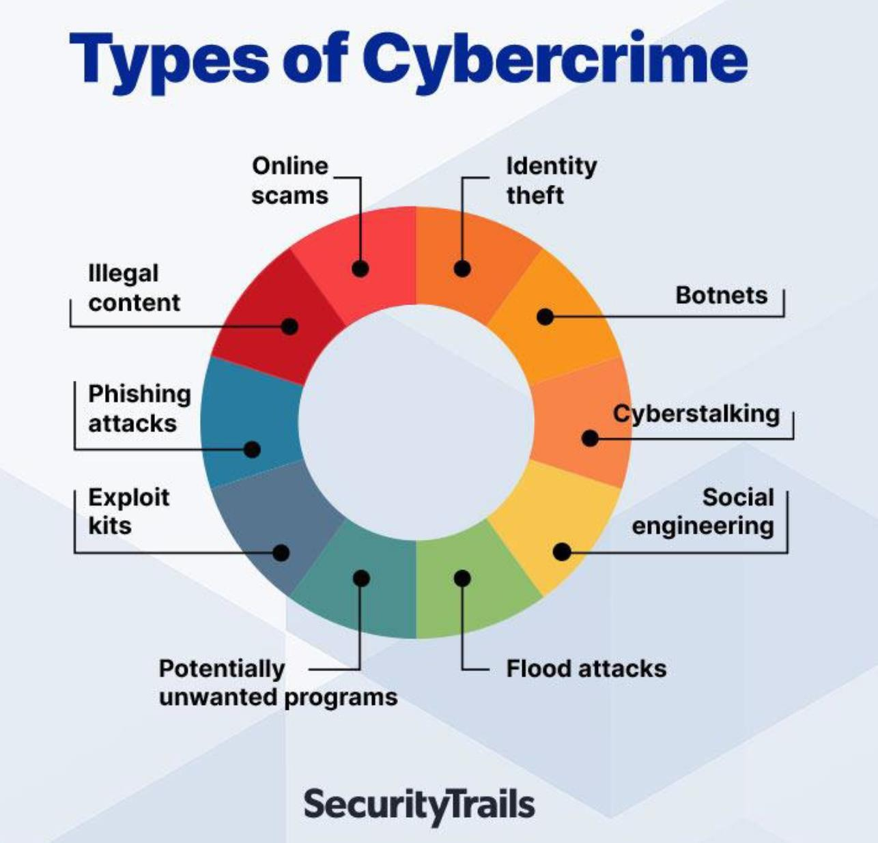

Slide 8
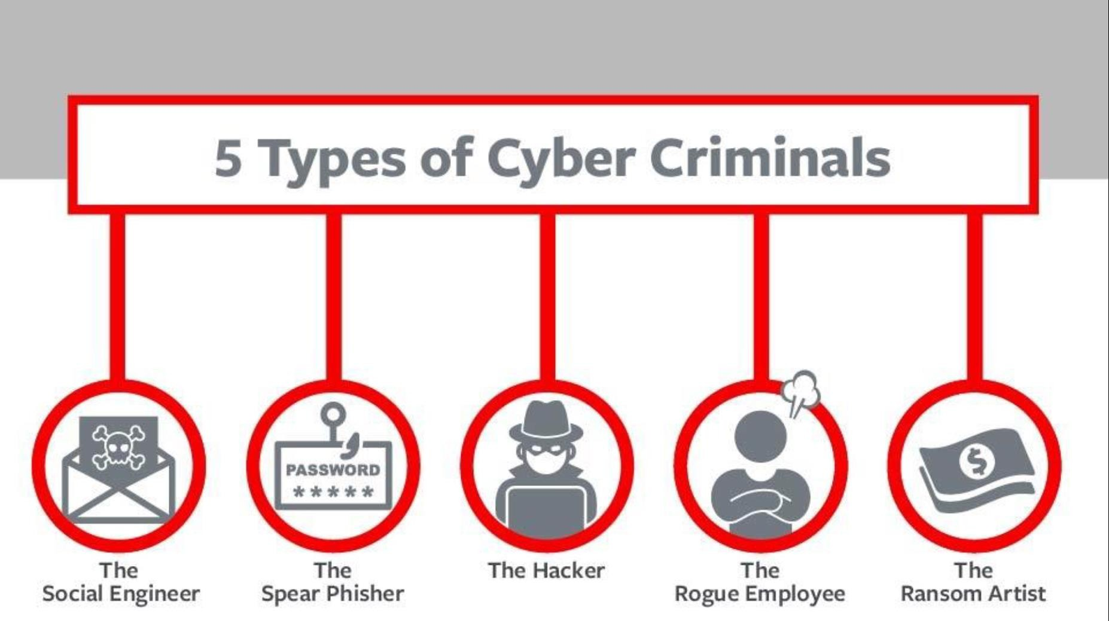

Slide 9
Types of Cyber Crime
• Hacking
• Phishing
• Denial of Service
• Spam Email
• Spyware, Adware
• Malware (Trojan, Virus, Worms etc. )
• Ransomware

Slide 10
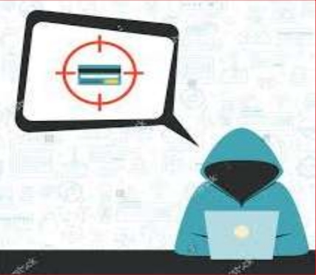
Hacking
• Hacking in simple terms means an illegal intrusion into a computer system and/or network.
• It is also known as cracking. Government websites are the hot targets of the hackers due to the press coverage, it receives.

Slide 11
How To prevent hacking
It may be impossible to prevent computer hacking, however effective security controls including strong passwords, and the use of firewalls can helps.

Slide 12
Types of Cyber Attack by Percentage
• Financial fraud 11%
• Sabotage of data/networks 17%
• Theft of proprietary information 20%
• System penetration from the outside 25%
• Denial of Service 27%
• Unauthorized access by insiders 71%
• Employee abuse of internet privileges 79%
• Viruses 85%

Slide 13
Advantages of Cyber Security
• It will defend us from hacks and virus. It helps us to browse the safe website.
• Internet Security process all the incoming and outgoing data on our computer.
• The cyber security will defend us from critical attacks.
• The application of cyber security used in our PC needs update every week.
• The security developers will update their database every week once. Hence the new virus also detected.

Slide 14
Tips to Prevent ID Theft
Shred anything with your details on.
Check your statements and report anything suspicious.
Ensure your home network is secure.
Ignore emails saying “You’ve Won…” or from somebody you’re suspicious about.

Slide 15
Safety Tips to Cyber Crime
• Use Antivirus Software.
• Insert Firewalls.
• Uninstall unnecessary software.
• Maintain backup.
• Check security settings.
• Never give your full name or address to strangers.
• Learn more about the internet privacy.

Slide 16
Kali Linux
Kali Linux :is an open-source, Debian-based Linux distribution aimed at advanced Penetration Testing and Security Auditing. It does this by providing common tools, configurations, and automations which allows the user to focus on the task that needs to be completed, not the surrounding activity.
Why do hackers use Kali Linux?
Kali Linux is not only a free, convenient, and highly secure Linux OS but also includes over 600 tools for information security. Hackers commonly use Kali Linux because it has security analysis, security auditing, and penetration testing.

Slide 17
Kali Linux
Other Operating Systems (OS) for Ethical Hackers
Parrot Security OS.
DEFT Linux.
Samurai Web Testing Framework.
NodeZero Linux.
Linux Kodachi.
Blackarch Linux. Network Security Toolkit (NST)

Slide 18
Kali Linux Features
More than 600 penetration testing tools included
Free (as in beer) and always will be
Open source Git tree
FHS compliant
Wide-ranging wireless device support
Custom kernel, patched for injection
Developed in a secure environment
GPG signed packages and repositories
Multi-language support
Completely customizable
ARMEL and ARMHF support

Slide 19
Top Hacking Tools
For an instance, let’s just assume you want to know how a threat can occur and what damages it can create, at that point you need to think like a hacker and know the tools and techniques they are likely to use. Ethical hacking tools allow anyone to report security incidents by exploring vulnerabilities and flaws within companies to help make their systems and applications less vulnerable. The top hacking tools used by security experts and individuals are listed below:
1. Metasploit
2. Nmap
3. Wireshark
4. OpenVAS
5. Ettercap

Slide 20
Top Hacking Tools
1. Metasploit
Metasploit is an open source project written in Ruby that allows to use different cyber-security tools to discover remote software vulnerabilities and functions as an exploit development module.

Slide 21
Top Hacking Tools
2. Nmap
Network mapper is a free, open source security tool used to audit and manage operating system and network security for local as well as remote hosts. By using this tool we can detect open ports on remote hosts, network mapping, exploring vulnerabilities inside the network and audit security devices.

Slide 22
Top Hacking Tools
3. Wireshark
Wireshark is another free, open source software allows you to analyze network traffic in real time. It has sniffing technology from which you are able to intercept and see the results in human readable form. It also saves analysis for offline operation making it more effective.

Slide 23
Top Hacking Tools
4. OpenVAS
OpenVAS or Nessus is one of the best network vulnerability scanners used to detect remote vulnerabilities in any hosts. Mostly system administrators and DevOps professionals use this tool to perform simultaneous multiple scanning hosts. It has a powerful web-based interface able to exports all results in HTML, XML, LateX and plain text.

Slide 24
Top Hacking Tools
5. Ettercap
Ettercap is another famous packet sniffing tool for LAN networks, capable of handling active as well as passive scans and various encrypted protocols such as SSH and HTTPS. It performs network and host analysis with manipulation of the network over established connections, making easier to test man-in-the-middle attacks.
Some more tools including John the ripper (password cracking tool), Nikto (Web server scanner), SQLMap (launch SQL code injection tests on remote hosts), Wapiti (CLI based vulnerability scanner) and BeEF are effectively used to perform penetration testing.
This article will help you to understand the basic concepts of Ethical Hacking, how to become a Hacker, what are the types of hacking and hackers and the useful tools to perform penetration testing.

Slide 25
Digital Forensics
Digital forensic science is a branch of forensic science that focuses on the recovery and investigation of material found in digital devices related to cybercrime.

Slide 26
Digital Forensics
The term digital forensics was first used as a synonym for computer forensics. Since then, it has expanded to cover the investigation of any devices that can store digital data. Although the first computer crime was reported in 1978, followed by the Florida computers act, it wasn’t until the 1990s that it became a recognized term. It was only in the early 21st century that national policies on digital forensics emerged.
Digital forensics is the process of identifying, preserving, analyzing, and documenting digital evidence. This is done in order to present evidence in a court of law when required.
http://www.eccouncil.org/what-is-digital-forensics/

Slide 27



Digital Forensic Tools
Digital forensic tools were created to observe data on a device without damaging it. Presently, digital forensic tools can be classified as digital forensic open source tools, digital forensics hardware tools, and many others.
The Sleuth Kit
The Sleuth Kit (earlier known as TSK) is a collection of Unix- and Windows-based utilities that extract data from computer systems. It is an open-source software that analyzes disk images created by “dd” and recovers data from them. With this software, professionals can gather data during incident response or from live systems. Professionals can integrate TSK with more extensive forensics tools.
FTK Imager
FTK Imager is an acquisition and imaging tool responsible for data preview that allows the user to assess the device in question quickly. The tool can also create forensic images (copies) of the device without damaging the original evidence.
Xplico
Xplico is a network forensic analysis tool (NFAT) that helps reconstruct the data acquired using other packet sniffing tools like Wireshark. It is free and open-source software that uses Port Independent Protocol Identification (PIPI) to recognize network protocols. The tool is built on four key components: Decoder Manager, IP Decoder, Data Manipulators, and Visualization System.

Slide 28
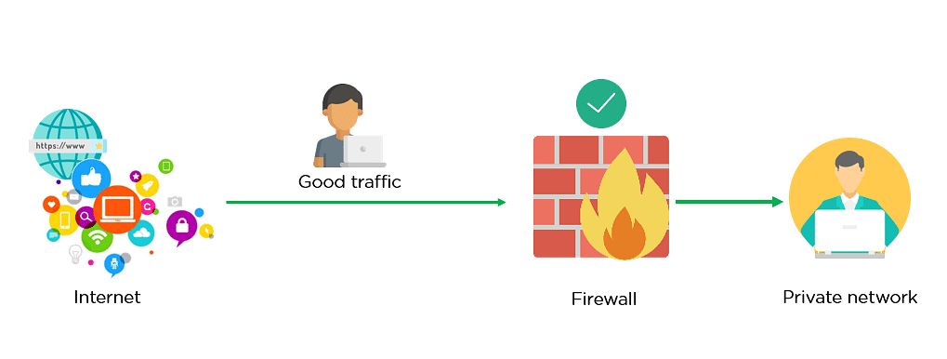
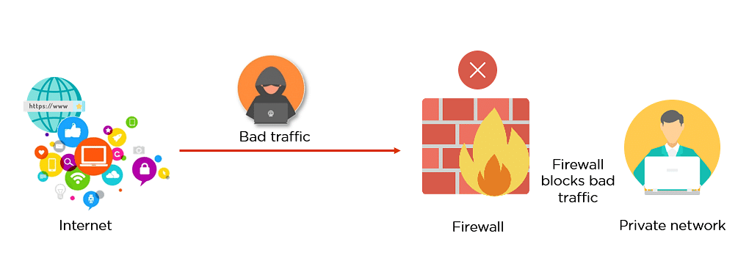
Firewall
What Is Firewall?
Firewalls prevent unauthorized access to networks through software or firmware. By utilizing a set of rules, the firewall examines and blocks incoming and outgoing traffic.

Slide 29
Firewall
History of Firewall
Network firewalls have evolved over the years to address several threats in the security landscape. Firewalls will remain crucial to organizations and society. So, let’s look at a brief history of firewalls.
1989 - Birth of packet filtering firewalls
1992 - First commercial firewall DEC SEAL
1994 - First of the stateful firewalls appear
2004 - IDC coins the term UTM (unified threat management)
2009 - Next Generation Firewall (NGFW) was introduced by Gartner
Now that you know the what is firewall and its history, let’s dive deeper into understanding how a firewall works.

Slide 30
Firewall
Why Are Firewalls Important?
Firewalls are designed with modern security techniques that are used in a wide range of applications. In the early days of the internet, networks needed to be built with new security techniques, especially in the client-server model, a central architecture of modern computing. That's where firewalls have started to build the security for networks with varying complexities. Firewalls are known to inspect traffic and mitigate threats to the devices.

Slide 31
Firewall
How Does a Firewall Work?
A firewalls filter the network traffic within a private network. It analyses which traffic should be allowed or restricted based on a set of rules. Think of the firewall like a gatekeeper at your computer’s entry point which only allows trusted sources, or IP addresses, to enter your network.
A firewall welcomes only those incoming traffic that has been configured to accept. It distinguishes between good and malicious traffic and either allows or blocks specific data packets on pre-established security rules.

Slide 32
Firewall
Types of Firewalls
A firewall can either be software or hardware.
1- Software firewalls are programs installed on each computer, and they regulate network traffic through applications and port numbers. Meanwhile,
2- Hardware firewalls are the equipment established between the gateway and your network. Additionally, you call a firewall delivered by a cloud solution as a cloud firewall.
The most common firewall types based on methods of operation are:
Packet-filtering firewalls
Proxy firewalls
NAT firewalls
Web application firewalls
Next-gen firewalls (NGFW)

Slide 33
Firewall
Limitations of a Firewall
Firewalls are not able to stop the users from accessing the data or information from malicious websites, making them vulnerable to internal threats or attacks.
It is not able to protect against the transfer of virus-infected files or software if security rules are misconfigured, against non-technical security risks (social engineering)
It does not prevent misuse of passwords and attackers with modems from dialing in to or out of the internal network.
Already infected systems are not secured by Firewalls.

Slide 34
Firewall
Difference Between a Firewall and Antivirus
Firewall
A firewall is essential software or firmware in network security that is used to prevent unauthorized access to a network.
It is used to inspect the incoming and outgoing traffic with the help of a set of rules to identify and block threats by implementing it in software or hardware form.
Firewalls can be used in both personal and enterprise settings, and many devices come with one built-in, including Mac, Windows, and Linux computers.
Antivirus
Antivirus is also an essential component of network security. It is basically an application or software used to provide security from malicious software coming from the internet.
An antivirus working is based upon 3 main actions, Detection, Identification, and Removal of threats.
Antivirus can deal with external threats as well as internal threats by implementing only through software

Slide 35
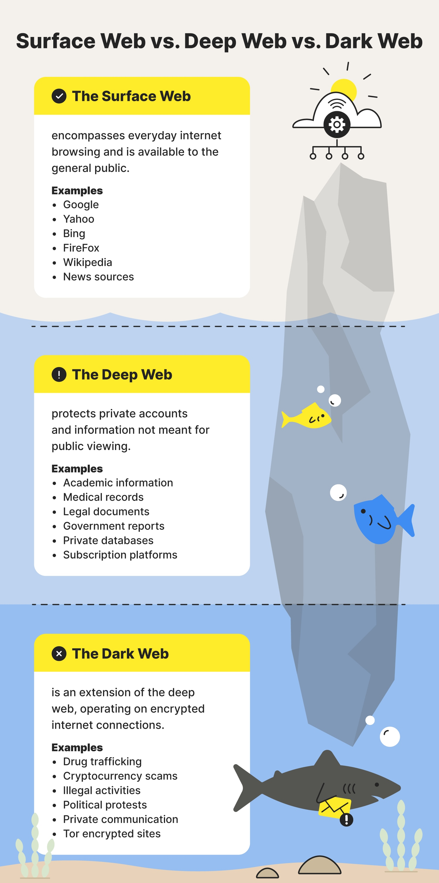
Web, Deep Web & Dark Web
Web(Surface Web)
The Surface Web is what users access in their regular day-to-day activity. It is available to the general public using standard search engines and can be accessed using standard web browsers that do not require any special configuration,

Slide 36
Web, Deep Web & Dark Web
Deep Web:
It is the web that cannot be accessed by the search engines, like government private data, bank data, cloud data, etc. These data are sensitive and private, so kept out of reach.
It is used to provide access to a specific group of people. On the dark Web, users do intentionally bury data.

Slide 37
Web, Deep Web & Dark Web
Dark Web:
The dark web refers to encrypted online content that is not indexed by conventional search engines. Darknet provides a user with anonymity but service was introduced that allowed someone to host a website on the darknet and remain anonymous.
This attracted people who do illegal stuff to sell things without getting caught.
One example is a website called the silk road which was on a darknet called TOR, used to sell drugs, and was taken down by the FBI.

Slide 38
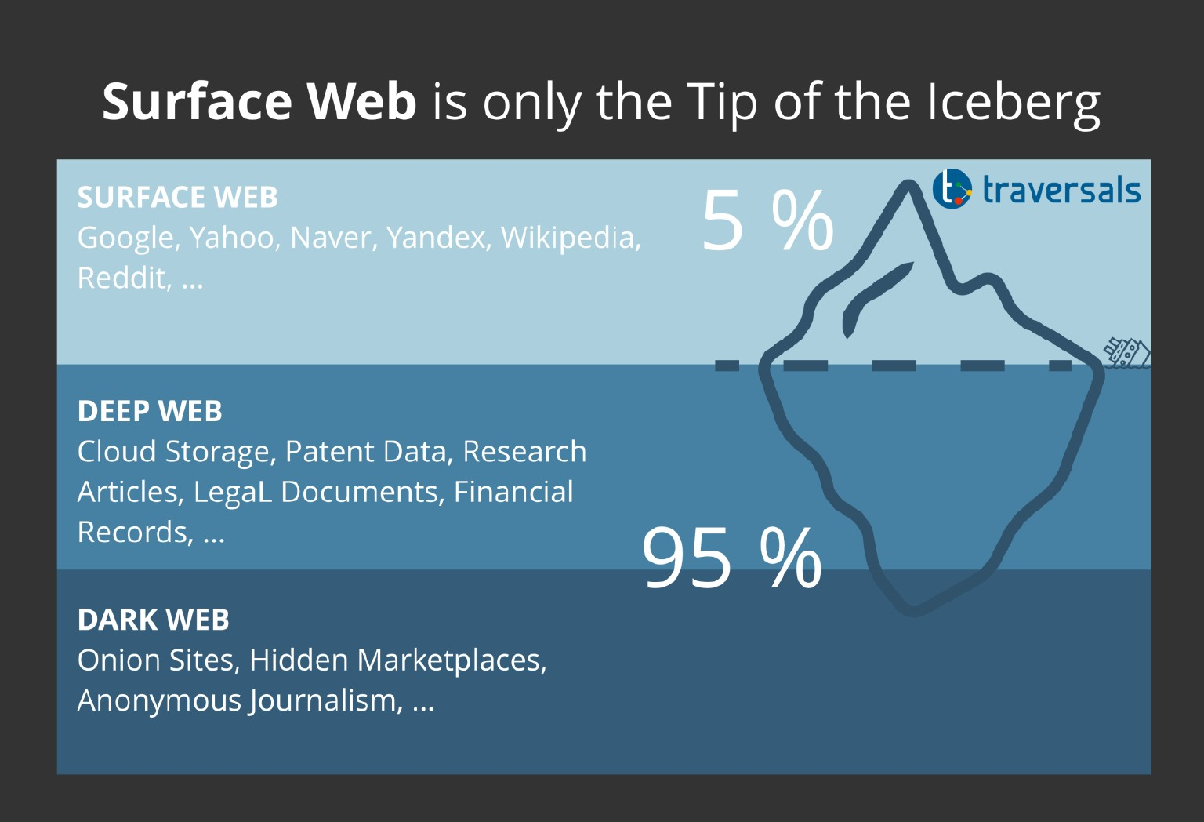
Web, Deep Web & Dark Web

Slide 39
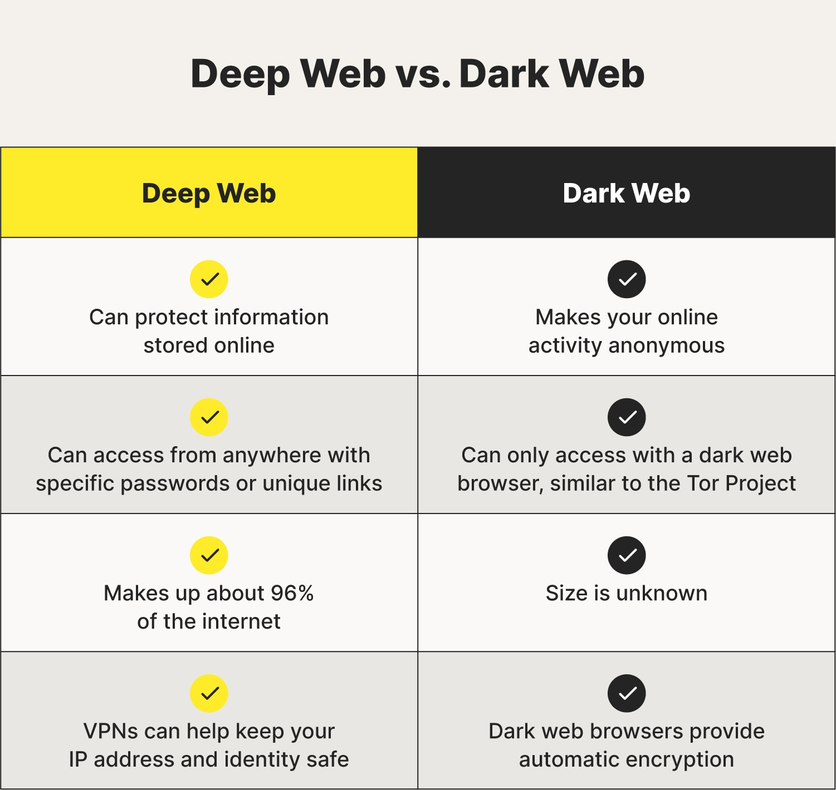
Web, Deep Web & Dark Web

Slide 40
Thanks you

